Slide 1

F
Simulation
PowerPoint presentation to accompany
Heizer and Render
Operations Management, 10e
Principles of Operations Management, 8e
PowerPoint slides by Jeff Heyl

Slide 2
Outline
What Is Simulation?
Advantages and Disadvantages of Simulation
Monte Carlo Simulation
Simulation of A Queuing Problem
Simulation and Inventory Analysis

Slide 3
Learning Objectives
When you complete this module you should be able to:
List the advantages and disadvantages of modeling with simulation
Perform the five steps in a Monte Carlo simulation
Simulate a queuing problem
Simulate an inventory problem
Use Excel spreadsheets to create a simulation

Slide 4
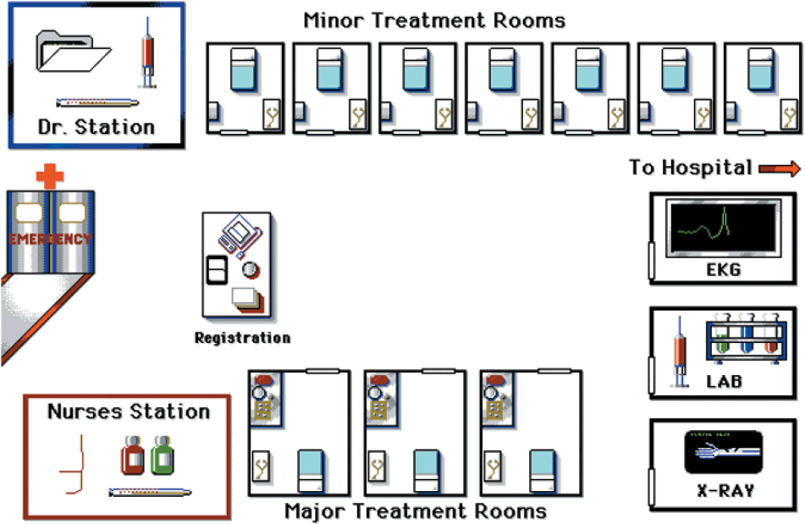
Computer Analysis
Notes:
This slide provides some reasons that capacity is an issue. The following slides guide a discussion of capacity.

Slide 5
What is Simulation?
An attempt to duplicate the features, appearance, and characteristics of a real system
  To imitate a real-world situation mathematically
  To study its properties and operating characteristics
  To draw conclusions and make action decisions based on the results of the simulation
Notes:
This slide provides some reasons that capacity is an issue. The following slides guide a discussion of capacity.

Slide 6
Simulation Applications
Ambulance location and dispatching Assembly-line balancing Parking lot and harbor design Distribution system design Scheduling aircraft Labor-hiring decisions Personnel scheduling Traffic-light timing Voting pattern prediction | Bus scheduling Design of library operations Taxi, truck, and railroad dispatching Production facility scheduling Plant layout Capital investments Production scheduling Sales forecasting Inventory planning and control
Table F.1
Notes:
This slide can be used to frame a discussion of capacity.
Points to be made might include:
- capacity definition and measurement is necessary if we are to develop a production schedule
- while a process may have “maximum” capacity, many factors prevent us from achieving that capacity on a continuous basis.
Students should be asked to suggest factors which might prevent one from achieving maximum capacity.

Slide 7
What Is Simulation?
Define the problem
Introduce the important variables associated with the problem
Construct a numerical model
Set up possible courses of action for testing by specifying values of variables
Run the experiment
Consider the results (possibly modifying the model or changing data inputs)
Decide what course of action to take

Slide 8
The
Process of Simulation
Define problem
Introduce variables
Construct model
Specify values
of variables
Conduct simulation
Examine results
Select best course
Figure F.1
Notes:
This slide can be used to frame a discussion of capacity.
Points to be made might include:
- capacity definition and measurement is necessary if we are to develop a production schedule
- while a process may have “maximum” capacity, many factors prevent us from achieving that capacity on a continuous basis.
Students should be asked to suggest factors which might prevent one from achieving maximum capacity.

Slide 9
Advantages of Simulation
Relatively straightforward and flexible
Can be used to analyze large and complex real-world situations that cannot be solved by conventional models
Real-world complications can be included that most OM models cannot permit
“Time compression” is possible
Notes:
This slide can be used to frame a discussion of capacity.
Points to be made might include:
- capacity definition and measurement is necessary if we are to develop a production schedule
- while a process may have “maximum” capacity, many factors prevent us from achieving that capacity on a continuous basis.
Students should be asked to suggest factors which might prevent one from achieving maximum capacity.

Slide 10
Advantages of Simulation
Allows “what-if” types of questions
Does not interfere with real-world systems
Can study the interactive effects of individual components or variables in order to determine which ones are important
Notes:
This slide can be used to frame a discussion of capacity.
Points to be made might include:
- capacity definition and measurement is necessary if we are to develop a production schedule
- while a process may have “maximum” capacity, many factors prevent us from achieving that capacity on a continuous basis.
Students should be asked to suggest factors which might prevent one from achieving maximum capacity.

Slide 11
Disadvantages of Simulation
Can be very expensive and may take months to develop
It is a trial-and-error approach that may produce different solutions in repeated runs
Managers must generate all of the conditions and constraints for solutions they want to examine
Each simulation model is unique
Notes:
This slide can be used to frame a discussion of capacity.
Points to be made might include:
- capacity definition and measurement is necessary if we are to develop a production schedule
- while a process may have “maximum” capacity, many factors prevent us from achieving that capacity on a continuous basis.
Students should be asked to suggest factors which might prevent one from achieving maximum capacity.

Slide 12
Monte Carlo Simulation
The Monte Carlo method may be used
when the model contains elements that
exhibit chance in their behavior
Set up probability distributions for important variables
Build a cumulative probability distribution for each variable
Establish an interval of random numbers for each variable
Generate random numbers
Simulate a series of trials
Notes:
This slide can be used to frame a discussion of capacity.
Points to be made might include:
- capacity definition and measurement is necessary if we are to develop a production schedule
- while a process may have “maximum” capacity, many factors prevent us from achieving that capacity on a continuous basis.
Students should be asked to suggest factors which might prevent one from achieving maximum capacity.

Slide 13
Probability of Demand
(1) | (2) | (3) | (4)
Demand for Tires | Frequency | Probability of Occurrence | Cumulative Probability
0 | 10 | 10/200 = .05 | .05
1 | 20 | 20/200 = .10 | .15
2 | 40 | 40/200 = .20 | .35
3 | 60 | 60/200 = .30 | .65
4 | 40 | 40/200 = .20 | .85
5 | 30 | 30/ 200 = .15 | 1.00
 | 200 days | 200/200 = 1.00
Table F.2
Notes:
This slide can be used to frame a discussion of capacity.
Points to be made might include:
- capacity definition and measurement is necessary if we are to develop a production schedule
- while a process may have “maximum” capacity, many factors prevent us from achieving that capacity on a continuous basis.
Students should be asked to suggest factors which might prevent one from achieving maximum capacity.

Slide 14
Assignment of Random Numbers
Daily Demand | Probability | Cumulative Probability | Interval of Random Numbers
0 | .05 | .05 | 01 through 05
1 | .10 | .15 | 06 through 15
2 | .20 | .35 | 16 through 35
3 | .30 | .65 | 36 through 65
4 | .20 | .85 | 66 through 85
5 | .15 | 1.00 | 86 through 00
Table F.3
Notes:
This slide can be used to frame a discussion of capacity.
Points to be made might include:
- capacity definition and measurement is necessary if we are to develop a production schedule
- while a process may have “maximum” capacity, many factors prevent us from achieving that capacity on a continuous basis.
Students should be asked to suggest factors which might prevent one from achieving maximum capacity.

Slide 15
Table of Random Numbers
52 | 50 | 60 | 52 | 05
37 | 27 | 80 | 69 | 34
82 | 45 | 53 | 33 | 55
69 | 81 | 69 | 32 | 09
98 | 66 | 37 | 30 | 77
96 | 74 | 06 | 48 | 08
33 | 30 | 63 | 88 | 45
50 | 59 | 57 | 14 | 84
88 | 67 | 02 | 02 | 84
90 | 60 | 94 | 83 | 77
Table F.4
Notes:
This slide can be used to frame a discussion of capacity.
Points to be made might include:
- capacity definition and measurement is necessary if we are to develop a production schedule
- while a process may have “maximum” capacity, many factors prevent us from achieving that capacity on a continuous basis.
Students should be asked to suggest factors which might prevent one from achieving maximum capacity.

Slide 16
Simulation Example 1
Day Number | Random Number | Simulated Daily Demand
1 | 52 | 3
2 | 37 | 3
3 | 82 | 4
4 | 69 | 4
5 | 98 | 5
6 | 96 | 5
7 | 33 | 2
8 | 50 | 3
9 | 88 | 5
10 | 90 | 5
 |  | 39 Total
 |  | 3.9 Average
Select random numbers from Table F.3
Notes:
This slide can be used to frame a discussion of capacity.
Points to be made might include:
- capacity definition and measurement is necessary if we are to develop a production schedule
- while a process may have “maximum” capacity, many factors prevent us from achieving that capacity on a continuous basis.
Students should be asked to suggest factors which might prevent one from achieving maximum capacity.

Slide 17
Simulation Example 1
Day Number | Random Number | Simulated Daily Demand
1 | 52 | 3
2 | 37 | 3
3 | 82 | 4
4 | 69 | 4
5 | 98 | 5
6 | 96 | 5
7 | 33 | 2
8 | 50 | 3
9 | 88 | 5
10 | 90 | 5
 |  | 39 Total
 |  | 3.9 Average
5
i =1
Expected
demand
= ∑ (probability of i units) x (demand of i units)
= (.05)(0) + (.10)(1) + (.20)(2) + (.30)(3) + (.20)(4) + (.15)(5)
= 0 + .1 + .4 + .9 + .8 + .75
= 2.95 tires
Notes:
This slide can be used to frame a discussion of capacity.
Points to be made might include:
- capacity definition and measurement is necessary if we are to develop a production schedule
- while a process may have “maximum” capacity, many factors prevent us from achieving that capacity on a continuous basis.
Students should be asked to suggest factors which might prevent one from achieving maximum capacity.

Slide 18
Queuing Simulation
Overnight barge arrival rates
Table F.5
Number of Arrivals | Probability | Cumulative Probability | Random-Number Interval
0 | .13 | .13 | 01 through 13
1 | .17 | .30 | 14 through 30
2 | .15 | .45 | 31 through 45
3 | .25 | .70 | 46 through 70
4 | .20 | .90 | 71 through 90
5 | .10 | 1.00 | 91 through 00
 | 1.00
Notes:
This slide can be used to frame a discussion of capacity.
Points to be made might include:
- capacity definition and measurement is necessary if we are to develop a production schedule
- while a process may have “maximum” capacity, many factors prevent us from achieving that capacity on a continuous basis.
Students should be asked to suggest factors which might prevent one from achieving maximum capacity.

Slide 19
Queuing Simulation
Barge unloading rates
Table F.6
Daily Unloading Rates | Probability | Cumulative Probability | Random-Number Interval
1 | .05 | .05 | 01 through 05
2 | .15 | .20 | 06 through 20
3 | .50 | .70 | 21 through 70
4 | .20 | .90 | 71 through 90
5 | .10 | 1.00 | 91 through 00
 | 1.00
Notes:
This slide can be used to frame a discussion of capacity.
Points to be made might include:
- capacity definition and measurement is necessary if we are to develop a production schedule
- while a process may have “maximum” capacity, many factors prevent us from achieving that capacity on a continuous basis.
Students should be asked to suggest factors which might prevent one from achieving maximum capacity.

Slide 20
Queuing Simulation
(1) Day | (2) Number Delayed from Previous Day | (3) Random Number | (4) Number of Nightly Arrivals | (5) Total to Be Unloaded | (6) Random Number | (7) Number Unloaded
1 | 0 | 52 | 3 | 3 | 37 | 3
2 | 0 | 06 | 0 | 0 | 63 | 0
3 | 0 | 50 | 3 | 3 | 28 | 3
4 | 0 | 88 | 4 | 4 | 02 | 1
5 | 3 | 53 | 3 | 6 | 74 | 4
6 | 2 | 30 | 1 | 3 | 35 | 3
7 | 0 | 10 | 0 | 0 | 24 | 0
8 | 0 | 47 | 3 | 3 | 03 | 1
9 | 2 | 99 | 5 | 7 | 29 | 3
10 | 4 | 37 | 2 | 6 | 60 | 3
11 | 3 | 66 | 3 | 6 | 74 | 4
12 | 2 | 91 | 5 | 7 | 85 | 4
13 | 3 | 35 | 2 | 5 | 90 | 4
14 | 1 | 32 | 2 | 3 | 73 | 3
15 | 0 | 00 | 5 | 5 | 59 | 3
 | 20 |  | 41 |  |  | 39
Notes:
This slide can be used to frame a discussion of capacity.
Points to be made might include:
- capacity definition and measurement is necessary if we are to develop a production schedule
- while a process may have “maximum” capacity, many factors prevent us from achieving that capacity on a continuous basis.
Students should be asked to suggest factors which might prevent one from achieving maximum capacity.

Slide 21
Queuing Simulation
20 delays
15 days
Average number of barges
delayed to the next day
=
= 1.33 barges delayed per day
41 arrivals
15 days
Average number of
nightly arrivals
=
= 2.73 arrivals per night
39 unloadings
15 days
Average number of barges
unloaded each day
=
= 2.60 unloadings per day
Notes:
This slide can be used to frame a discussion of capacity.
Points to be made might include:
- capacity definition and measurement is necessary if we are to develop a production schedule
- while a process may have “maximum” capacity, many factors prevent us from achieving that capacity on a continuous basis.
Students should be asked to suggest factors which might prevent one from achieving maximum capacity.

Slide 22
Inventory Simulation
Daily demand for Ace Drill
(1) Demand for Ace Drill | (2) Frequency | (3) Probability | (4) Cumulative Probability | (5) Interval of Random Numbers
0 | 15 | .05 | .05 | 01 through 05
1 | 30 | .10 | .15 | 06 through 15
2 | 60 | .20 | .35 | 16 through 35
3 | 120 | .40 | .75 | 36 through 75
4 | 45 | .15 | .90 | 76 through 90
5 | 30 | .10 | 1.00 | 91 through 00
 | 300 | 1.00
Table F.8
Notes:
This slide can be used to frame a discussion of capacity.
Points to be made might include:
- capacity definition and measurement is necessary if we are to develop a production schedule
- while a process may have “maximum” capacity, many factors prevent us from achieving that capacity on a continuous basis.
Students should be asked to suggest factors which might prevent one from achieving maximum capacity.

Slide 23
Inventory Simulation
Reorder lead time
(1) Demand for Ace Drill | (2) Frequency | (3) Probability | (4) Cumulative Probability | (5) Interval of Random Numbers
1 | 10 | .20 | .20 | 01 through 20
2 | 25 | .50 | .70 | 21 through 70
3 | 15 | .30 | 1.00 | 71 through 00
 | 50 | 1.00
Table F.9
Notes:
This slide can be used to frame a discussion of capacity.
Points to be made might include:
- capacity definition and measurement is necessary if we are to develop a production schedule
- while a process may have “maximum” capacity, many factors prevent us from achieving that capacity on a continuous basis.
Students should be asked to suggest factors which might prevent one from achieving maximum capacity.

Slide 24
Inventory Simulation
Begin each simulation day by checking to see if ordered inventory has arrived. If it has, increase current inventory by the quantity ordered.
Generate daily demand using probability distribution and random numbers.
Compute ending inventory. If on-hand is insufficient to meet demand, satisfy as much as possible and note lost sales.
Determine whether the day's ending inventory has reached the reorder point. If it has, and there are no outstanding orders, place an order. Choose lead time using probability distribution and random numbers.
Notes:
This slide can be used to frame a discussion of capacity.
Points to be made might include:
- capacity definition and measurement is necessary if we are to develop a production schedule
- while a process may have “maximum” capacity, many factors prevent us from achieving that capacity on a continuous basis.
Students should be asked to suggest factors which might prevent one from achieving maximum capacity.

Slide 25
Inventory Simulation
Order quantity = 10 units Reorder point = 5 units
Table F.10
(1) Day | (2) Units Received | (3) Beginning Inventory | (4) Random Number | (5) Demand | (6) Ending Inventory | (7) Lost Sales | (8) Order? | (9) Random Number | (10) Lead Time
1 |  | 10 | 06 | 1 | 9 | 0 | No
2 | 0 | 9 | 63 | 3 | 6 | 0 | No
3 | 0 | 6 | 57 | 3 | 3 | 0 | Yes | 02 | 1
4 | 0 | 3 | 94 | 5 | 0 | 2 | No
5 | 10 | 10 | 52 | 3 | 7 | 0 | No
6 | 0 | 7 | 69 | 3 | 4 | 0 | Yes | 33 | 2
7 | 0 | 4 | 32 | 2 | 2 | 0 | No
8 | 0 | 2 | 30 | 2 | 0 | 0 | No
9 | 10 | 10 | 48 | 3 | 7 | 0 | No
10 | 0 | 7 | 88 | 4 | 3 | 0 | Yes | 14 | 1
 |  |  |  |  | 41 | 2
Notes:
This slide can be used to frame a discussion of capacity.
Points to be made might include:
- capacity definition and measurement is necessary if we are to develop a production schedule
- while a process may have “maximum” capacity, many factors prevent us from achieving that capacity on a continuous basis.
Students should be asked to suggest factors which might prevent one from achieving maximum capacity.

Slide 26
Inventory Simulation
41 total units
10 days
Average ending inventory = = 4.1 units/day
2 sales lost
10 days
Average lost sales = = .2 unit/day
Average number of orders placed
3 orders
10 days
= = .3 order/day
Notes:
This slide can be used to frame a discussion of capacity.
Points to be made might include:
- capacity definition and measurement is necessary if we are to develop a production schedule
- while a process may have “maximum” capacity, many factors prevent us from achieving that capacity on a continuous basis.
Students should be asked to suggest factors which might prevent one from achieving maximum capacity.

Slide 27
Inventory Simulation
Daily order cost = (cost of placing 1 order) x
(number of orders placed per day)
= $10 per order x .3 order per day = $3
Daily holding cost = (cost of holding 1 unit for 1 day) x
(average ending inventory)
= 50¢ per unit per day x 4.1 units per day
= $2.05
Daily stockout cost = (cost per lost sale) x
(average number of lost sales per day)
= $8 per lost sale x .2 lost sales per day
= $1.60
Total daily inventory cost = Daily order cost + Daily holding cost + Daily stockout cost
= $6.65
Notes:
This slide can be used to frame a discussion of capacity.
Points to be made might include:
- capacity definition and measurement is necessary if we are to develop a production schedule
- while a process may have “maximum” capacity, many factors prevent us from achieving that capacity on a continuous basis.
Students should be asked to suggest factors which might prevent one from achieving maximum capacity.

Slide 28
Using Software in Simulation
Computers are critical in simulating complex tasks
General-purpose languages - BASIC, C++
Special-purpose simulation languages - GPSS, SIMSCRIPT
  Require less programming time for large simulations
  Usually more efficient and easier to check for errors
  Random-number generators are built in
Notes:
This slide can be used to frame a discussion of capacity.
Points to be made might include:
- capacity definition and measurement is necessary if we are to develop a production schedule
- while a process may have “maximum” capacity, many factors prevent us from achieving that capacity on a continuous basis.
Students should be asked to suggest factors which might prevent one from achieving maximum capacity.

Slide 29
Using Software in Simulation
Commercial simulation programs are available for many applications - Extend, Modsim, Witness, MAP/1, Enterprise Dynamics, Simfactory, ProModel, Micro Saint, ARENA
Spreadsheets such as Excel can be used to develop some simulations
Notes:
This slide can be used to frame a discussion of capacity.
Points to be made might include:
- capacity definition and measurement is necessary if we are to develop a production schedule
- while a process may have “maximum” capacity, many factors prevent us from achieving that capacity on a continuous basis.
Students should be asked to suggest factors which might prevent one from achieving maximum capacity.

Slide 30
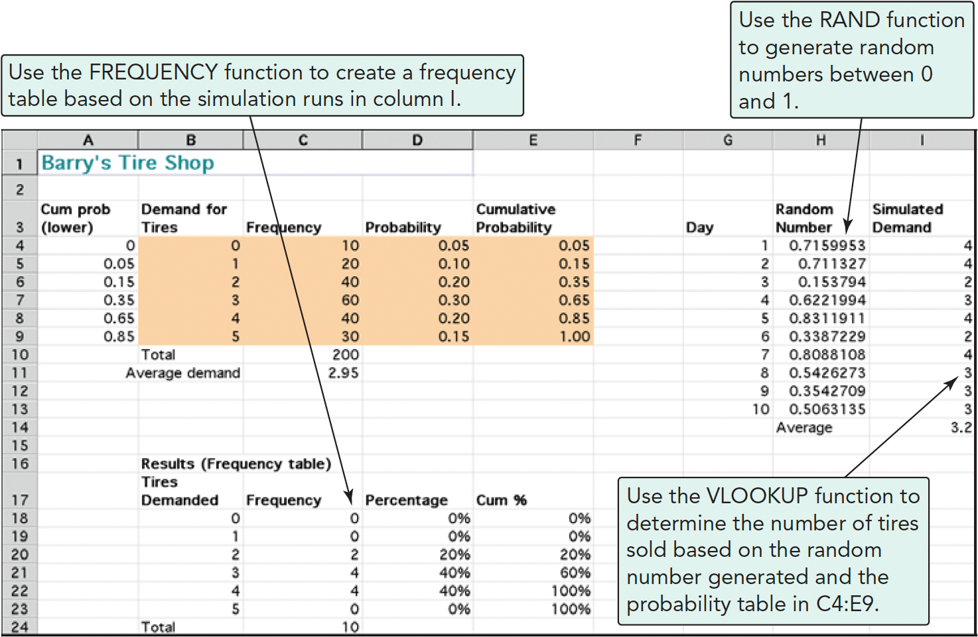
Using Software in Simulation
Notes:
This slide can be used to frame a discussion of capacity.
Points to be made might include:
- capacity definition and measurement is necessary if we are to develop a production schedule
- while a process may have “maximum” capacity, many factors prevent us from achieving that capacity on a continuous basis.
Students should be asked to suggest factors which might prevent one from achieving maximum capacity.

Slide 31

All rights reserved. No part of this publication may be reproduced, stored in a retrieval system, or transmitted, in any form or by any means, electronic, mechanical, photocopying, recording, or otherwise, without the prior written permission of the publisher.
Printed in the United States of America.

